Slide 1

INTELLIGENT HOSPITAL
MANAGMENT
BY
2010030309-K MANIDEEP REDDY
2010030457-M.ABHIRAM
2010030064-I KAUSTUBH SASTRY
2010030197-K.V.MANOHAR KARTHIK

Slide 2

 INTRODUCTION
 LITERATURE SURVEY
 PROBLEM STATEMENT
 MODULES
TABLE OF
CONTENTS
 TOOLS
 WORK ALLOCATION
 CONCLUSION

Slide 3

Intelligent hospital is an application which is developed to
retrieve patient’s details easily. In this application doctor
directly collects all the information of the patient regarding the
disease like patient name, age, gender, B.P, weight blood test,
urine test place and the description of the disease. Doctor can
analyse the disease of the patient easily with in no time with
this information. Doctor can search the symptoms and find the
cure to the disease easily. Depending on the result found
related to patients symptoms doctor will prescribe medicines
to the patient. When doctor finds new symptoms he can add
the related information in the database which he can analyze
the same disease in future without any waste of time. Doctor
can view the graph which shows the level of various disease in
various locations.
INTRODUCTION

Slide 4

1. “A hospital resource and patient management system based on
real-time data capture and intelligent decision making”
Author(s): Musa, A. Lancashire Bus. Sch., Univ. of Central
Lancashire, Preston, UK Yusuf, Y, Meckel.M. Systems and
Informatics (ICSAI), 2012 International Conference
LITREATURE
SURVEY
One of themajor challenges existing hospital management systems
face is around operational efficiency and wait times between different
processes, departments and persons. This paper highlights such
limitations of existing systems and proposes a RFID(Radio Frequency
ID) and wireless sensor based , location and information management
framework that facilitates real time tracking of hospital assets,
personnel and patients as they move through pre-set procedures as
part of daily activities of the hospitals

Slide 5
2.“Study on information system of health care services
management in hospital”
Author(s): Daiping Hu, Antai Sch. of Manage., Shanghai Jiaotong
Univ., China Weiguo Xu ; Huizhang Shen ; Mengyu Li. Services
Systems and Services Management, 2005. Proceedings of ICSSSM
'05. 2005 International Conference .
LITREATURE
SURVEY
This paper reviews the HIS (Hospital Information Systems) which are
widely used in many hospitals in China mainly to provide easier and
faster way for daily medical tasks /activities with a GUI And provides
for overcoming some of the limitations of HIS , eg. HIS aims at
improving quality of health care services but do not have way of
evaluating /measuring those. So this paper proposes HSMS (Hospital
Services Management System) which aims at improving quality of
services, identifying cost reduction areas , analyses and evaluate /rate
heath care services .

Slide 6
“Developing Effective Hospital Management Information
Systems: A Technology Ecosystem Perspective”.
Authors: Dr Christopher Bain MBBS, Master Info.
The author of this paper focuses more on needs of hospital manager
and the ecosystem in which he/she operates. The internal and external
Environment shaping factors ESFs that bear an impact or association
on daily hospital activities and decision-making process that the
hospital manager has to go through in each situations. Some of the
challenges that this ecosystem needs to work on are high demand
pressure, greater customer satisfaction level and low profit margins.
This paper more so contributes to Planning, Design and development
aspects of any Hospital management system by highlighting ESFs that
should be considered
LITREATURE
SURVEY

Slide 7
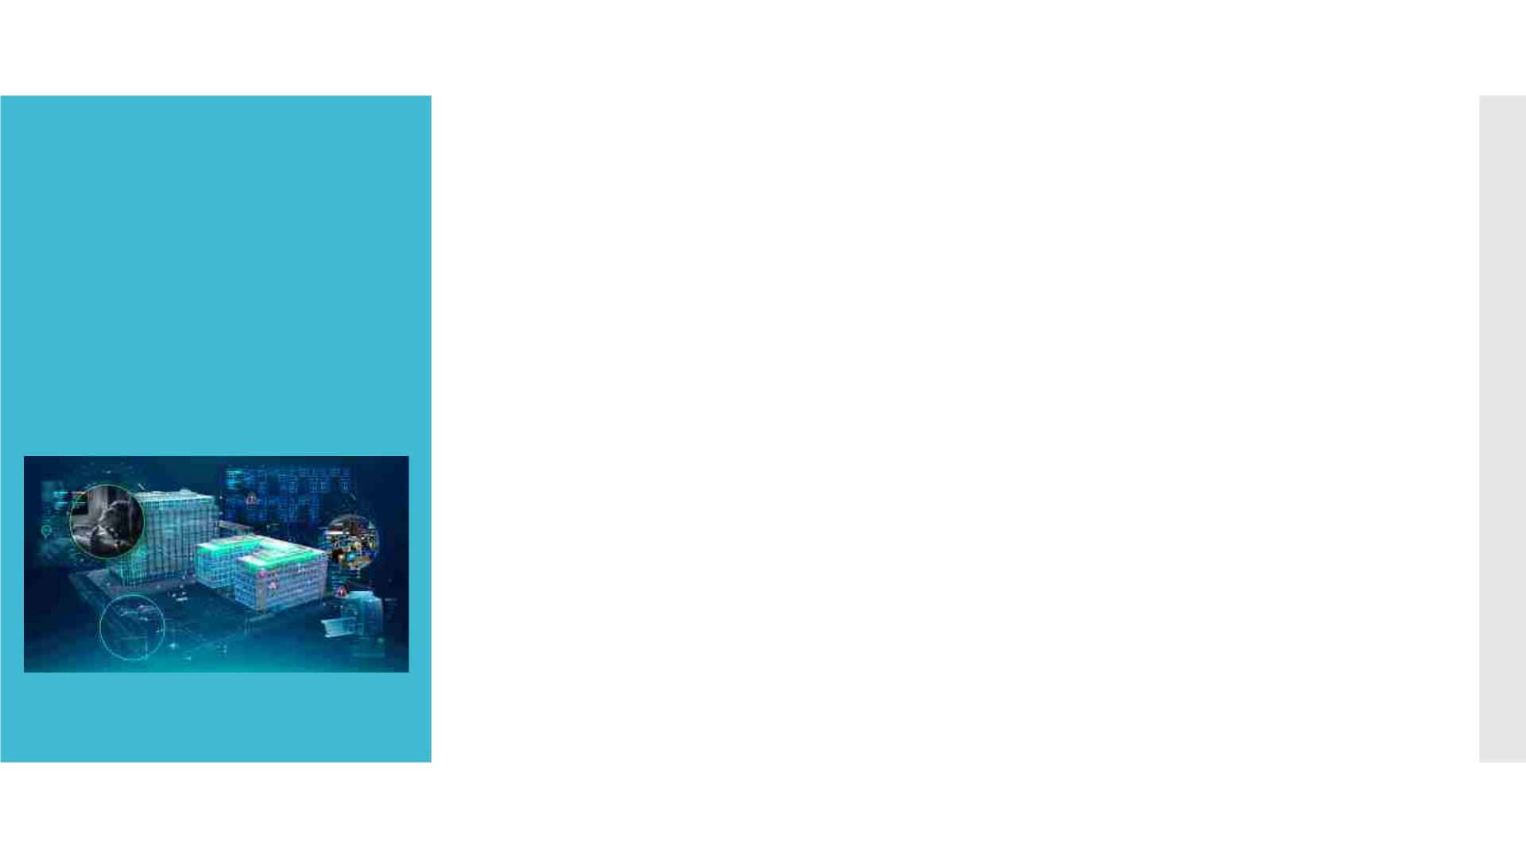
OBJECTIVE
 The main objective of this Intelligent Hospital application is to
save time of both patient and the doctor. To provide a quick
exploration of the disease. This application provides a search
option to the doctor where he can get the result very quickly by
selecting the symptoms of the patient. This application provides a
graph with the details of levels of the disease in various locations.

Slide 8

MODULES
 Doctor:
Doctor can register by entering the information. He can
by entering the unique username and
get login
password. Doctor can add patient details, search the
disease by selecting the symptoms and he can view the
graph of the disease levels in various locations.
 Help Desk:
The help desk module all the details of the patient like
name, age, place, gender, problem, date, time, B.P and
weight will be added and stored in the database.

Slide 9
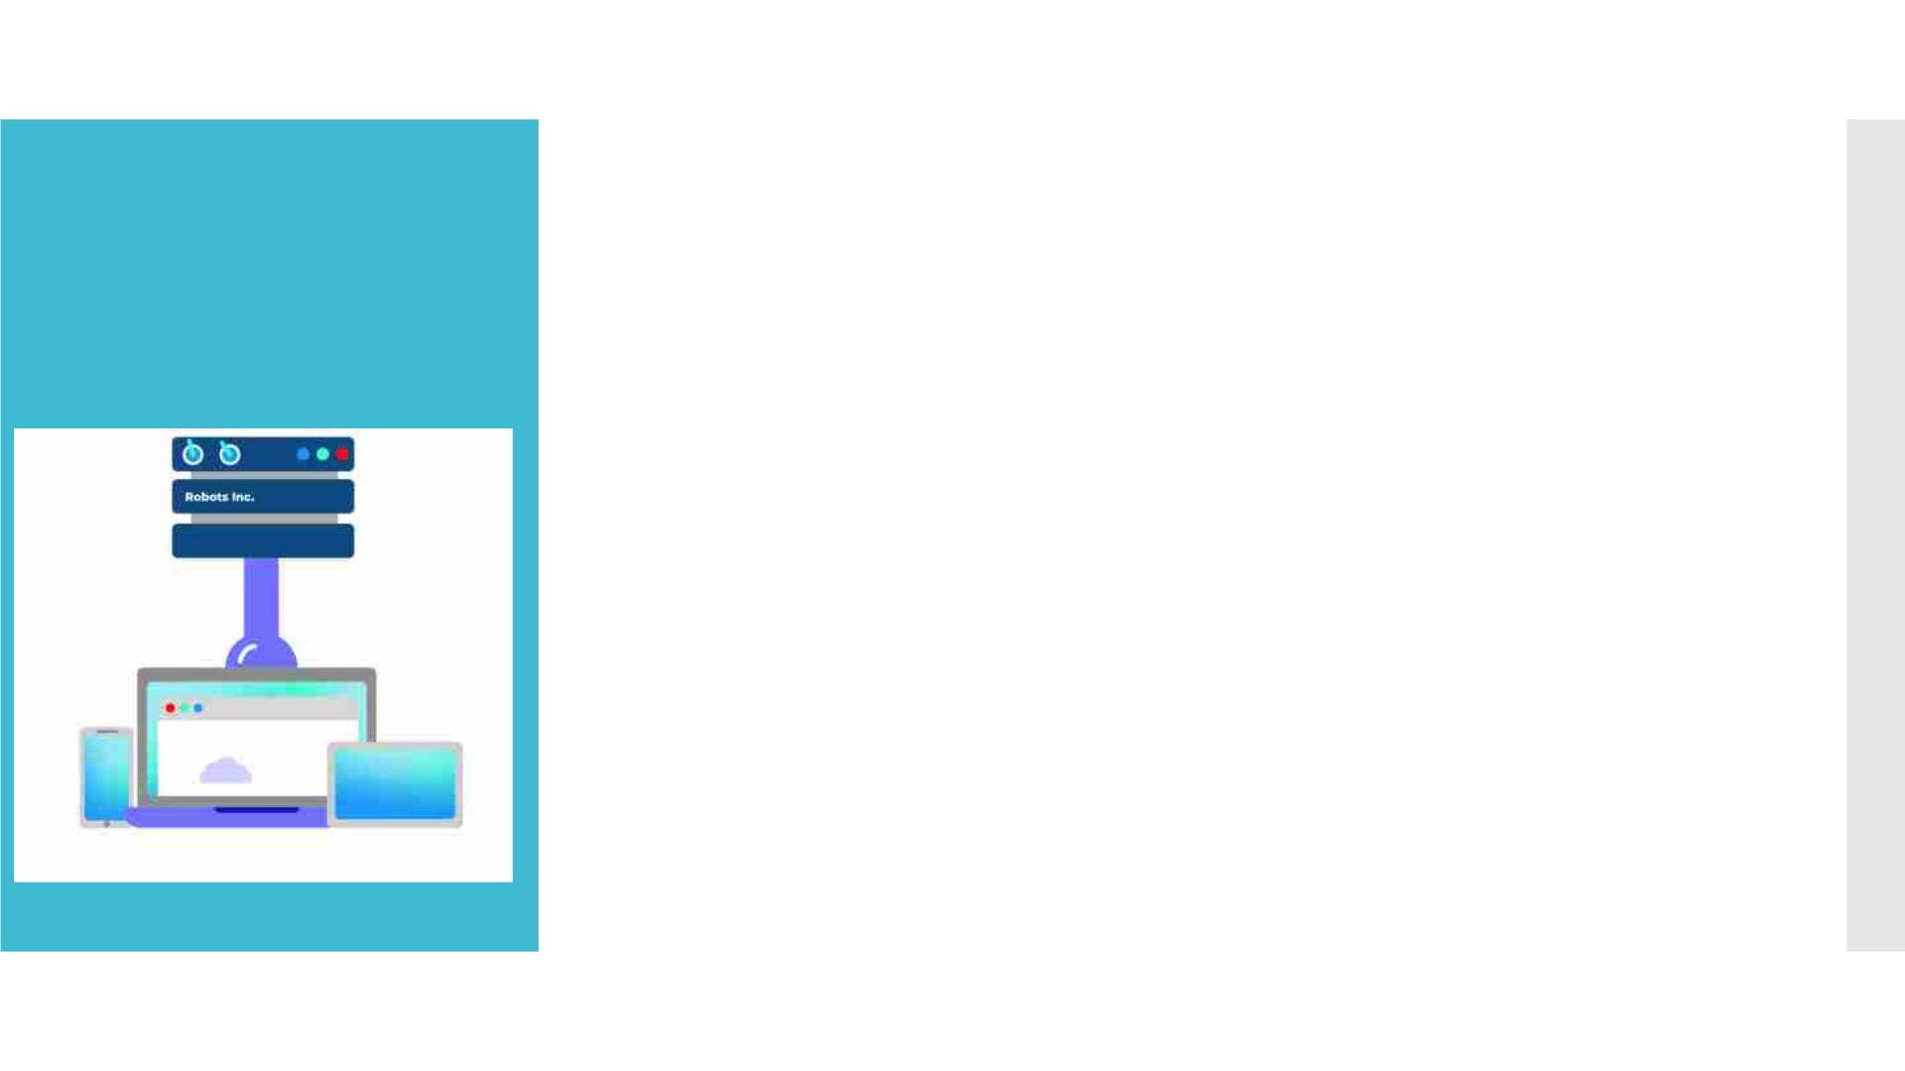
TOOLS
 Operating System : windows 10,11 later
 Web Server : Tomcat version 10
 Database server : My SQL ,Access
 Runtime Environment :Java Runtime Environment 5.0
 Development tools: Eclipse,Intellji idea
 Web Browser : chrome,edge,firefox,brave

Slide 10

WORK ALLOCATION
 2010030309- K Manideep Reddy-Development of project
 2010030064- I Kaustubh Sastry- Literature Review
 2010030457- M. Abhiram-GitHub Setup
 2010030197-K.V.Manohar Karthik- Literature Review

Slide 11

 Our application “Intelligent Hospital” maintains all the patient’s
information and the disease details securely. Using this application
patient details can be retrieved easily. This application guarantees
the accurate maintenance of the patient details and gives the cure
to the symptoms of the patient in very less time.Doctor can find
the treatment to the symptoms of the patient by clicking on the
search button which saves lot of time. This application also
provides graph for various diseases in various locations.
CONCLUSION

